Slide 1

Lecture 3： Bayes Filter Implementations Gaussian Filters
School of Mechanical Engineering and Automation
Dr. Chen Haoyao
hychen5@hitsz.edu.cn

Slide 2
Reminder -> Bayes Filters: Framework
Chapter 2
Given:
Stream of observations z and action data u:
Sensor model P(z|x).
Action model P(x|u,x’).
Prior probability of the system state P(x).
Wanted:
Estimate of the state X of a dynamical system.
The posterior of the state is also called Belief:

Slide 3
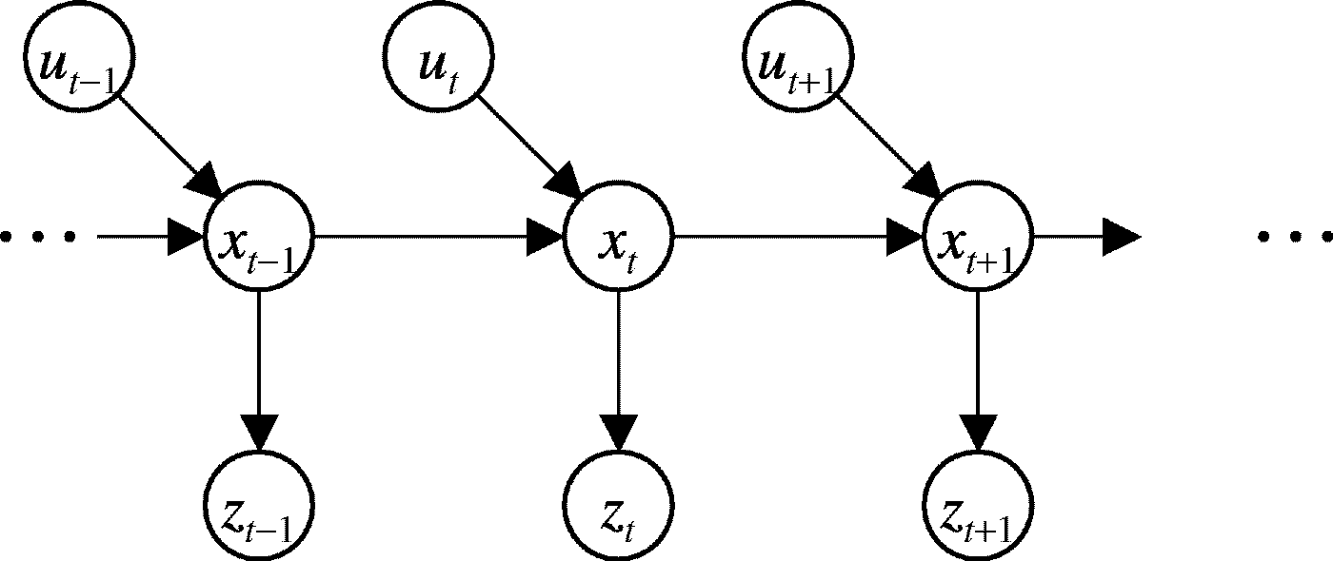
Bayes Graph
Chapter 2

Slide 4
Bayes Filters
z = observation
u = action
x = state
Bayes
Markov
Total prob.
Markov
Markov

Slide 5
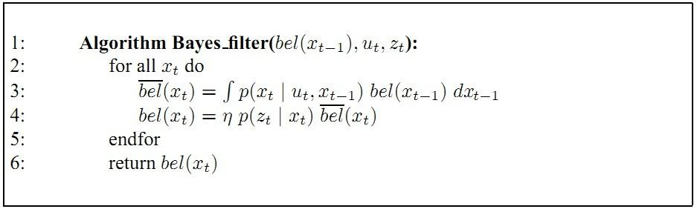
Bayes Filter
Prediction
Correction

Slide 6
Bayes Filter Reminder
Prediction
Correction

Slide 7
Example: A mobile Robot estimating the state of a door

Slide 8
Prior bel(X₀=open) = 0.5 bel(X₀=closed) = 0.5
p(Z_{t}=sense_open | X_{t} = is_open) = 0.6
p(Z_{t}=sense_closed | X_{t} = is_open) = 0.4
Sensing
Model:
p(Z_{t}=sense_open | X_{t} = is_closed) = 0.2
p(Z_{t}=sense_closed | X_{t} = is_closed) = 0.8
p(X_{t}=is_open | U_{t} = do_nothing, X_{t-1} = is_open) = 1
Action/Motion
Model:
p(X_{t}=is_closed | U_{t} = do_nothing, X_{t -1} = is_open) = 0
p(X_{t}=is_open | U_{t} = do_nothing, X_{t -1} = is_closed) = 0
p(X_{t}=is_closed | U_{t} = do_nothing, X_{t -1} = is_closed) = 1
p(X_{t}=is_open | U_{t} = push, X_{t-1} = is_open) = 1
p(X_{t}=is_closed | U_{t} = push, X_{t -1} = is_open) = 0
p(X_{t}=is_open | U_{t} = push, X_{t -1} = is_closed) = 0.8
p(X_{t}=is_closed | U_{t} = push, X_{t -1} = is_closed) = 0.2

Slide 9
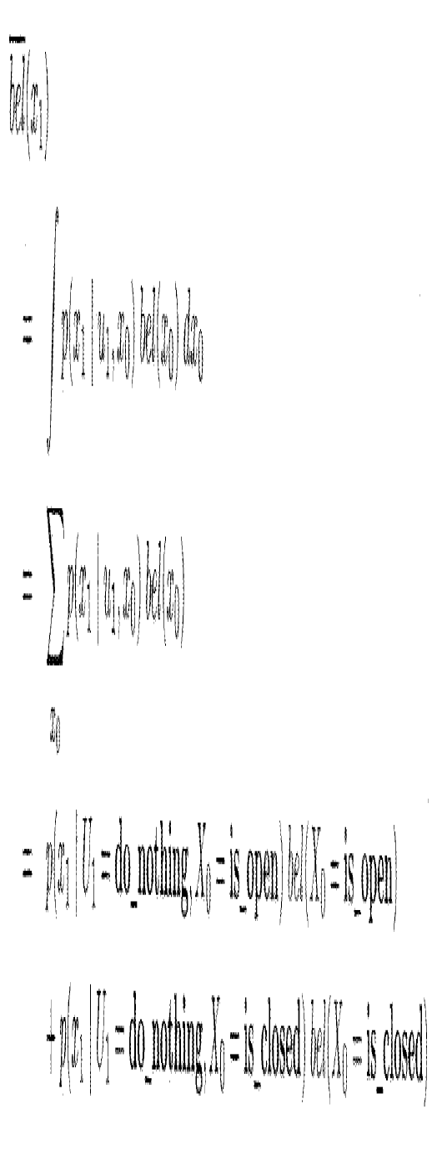
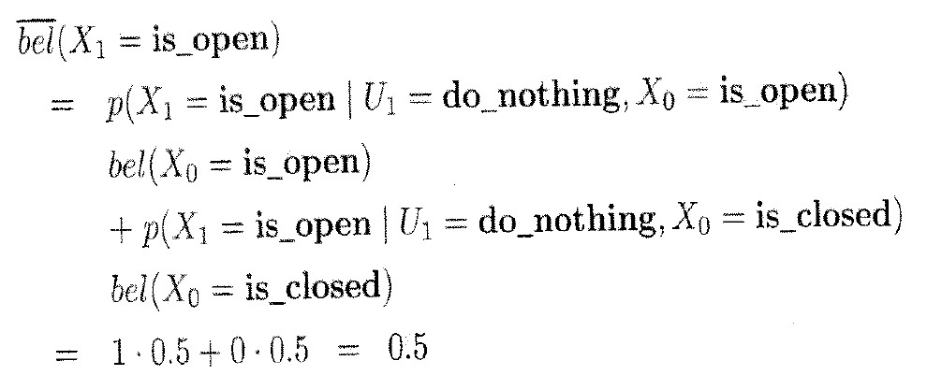
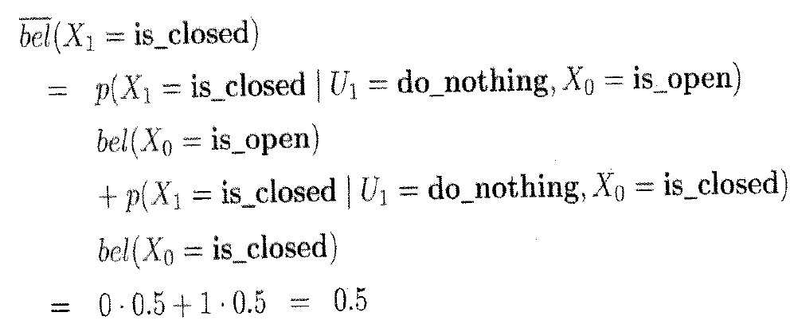
Input: U₁ =do_nothing Z₁ = sense_open bel(X₀)

Slide 10
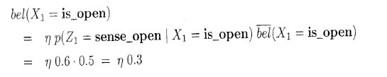
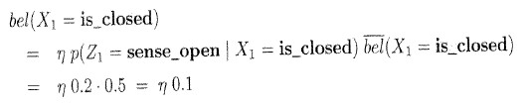

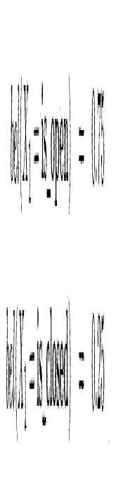
Input: U₁ =do_nothing Z₁ = sense_open bel(X₀)

Slide 11
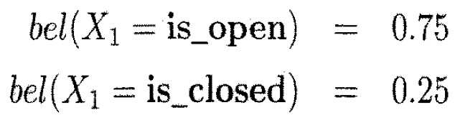
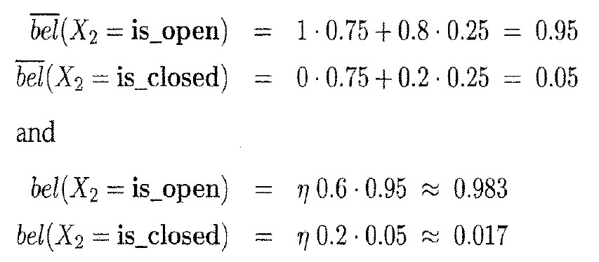
Input: U₂ =push Z₂ = sense_open bel(X₁)

Slide 12
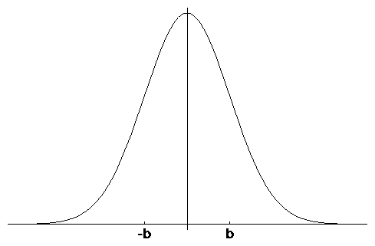
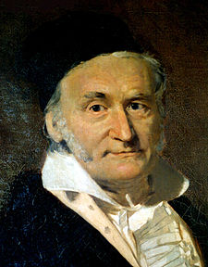
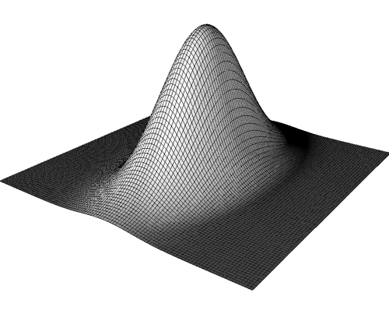
Gaussians
μ
Univariate
-σ
σ
Multivariate

Slide 13
Properties of Gaussians

Slide 14
Multivariate Gaussians
We stay in the “Gaussian world” as long as we start with Gaussians and perform only linear transformations.

Slide 15
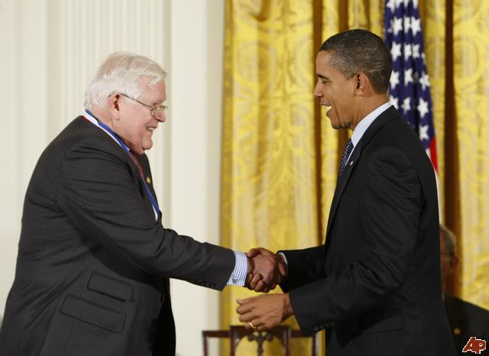
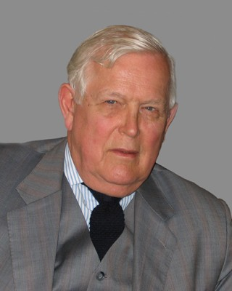
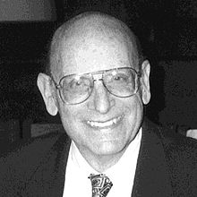
Rudolph E. Kalman
Peter Swerling
National Medal of Science, 2009
Kalman Filter
Swerling (1958), Kalman (1960) and Kalman and Bucy (1961)

Slide 16
Discrete Kalman Filter
Estimates the state x of a discrete-time controlled process that is governed by the linear stochastic difference equation
with a measurement

Slide 17
Components of a Kalman Filter
Matrix (nxn) that describes how the state evolves from t to t-1 without controls or noise.
Matrix (nxl) that describes how the control u_{t} changes the state from t to t-1.
Matrix (kxn) that describes how to map the state x_{t} to an observation z_{t}.
Random variables representing the process and measurement noise that are assumed to be independent and normally distributed with covariance R_{t} and Q_{t} respectively.

Slide 18
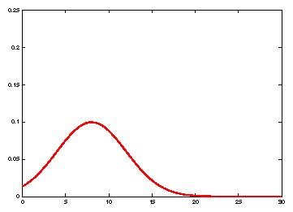
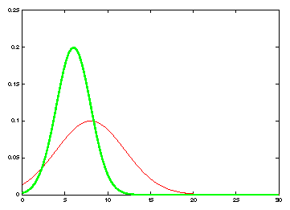
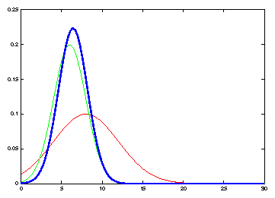
Kalman Filter Updates in 1D
Measurement
Prior belief
Updated belief

Slide 19
Kalman Filter Updates in 1D
General case

Slide 20
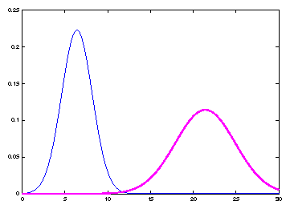
Kalman Filter Prediction in 1D
General case
Belief after motion

Slide 21
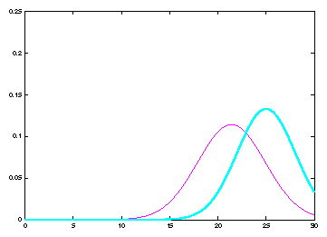
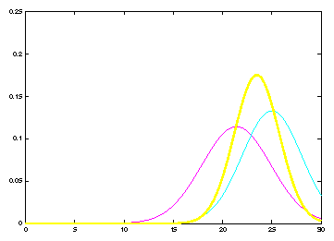
Kalman Filter Prediction and Updates
Belief after motion
New Measurement
Updated belief

Slide 22
Linear Gaussian Systems: Initialization
Initial belief is normally distributed:

Slide 23
Linear Gaussian Systems: Dynamics
Dynamics are linear function of state and control plus additive noise:

Slide 24
Linear Gaussian Systems: Dynamics
Notes:
This equation can be derived by just looking at the linear function of a Gaussian (ax+bu) and a convolution of two Gaussians

Slide 25
Linear Gaussian Systems: Observations
Observations are linear function of state plus additive noise:

Slide 26
Linear Gaussian Systems: Observations
Notes:
Just the multiplication of two Gaussians (ignore c matrix to make it easier
To derive mean, multiply K = sigma / sigma * q into the equation, expand the left mean by sigma + q / sigma + q
To derive variance, same approach: expand left sigma with sigma + q / sigma + q

Slide 27
Kalman Filter Algorithm
Algorithm Kalman_filter( μ_{t-1}, Σ_{t-1}, u_{t}, z_{t}):
Prediction:
Correction:
Return μ_{t}, Σ_{t}

Slide 28
The Prediction-Correction-Cycle
Prediction

Slide 29
The Prediction-Correction-Cycle
Correction

Slide 30
The Prediction-Correction-Cycle
Prediction
Correction

Slide 31
Kalman Filter Summary
Highly efficient: Polynomial in measurement dimensionality k and state dimensionality n: O(k^{2.376} + n²)
Optimal for linear Gaussian systems!
Most robotics systems are nonlinear!

Slide 32
Nonlinear Dynamic Systems
Most realistic robotic problems involve nonlinear functions

Slide 33
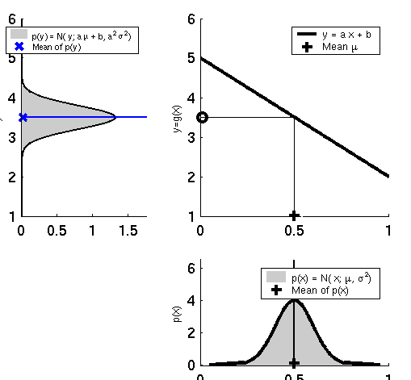
Linearity Assumption Revisited

Slide 34
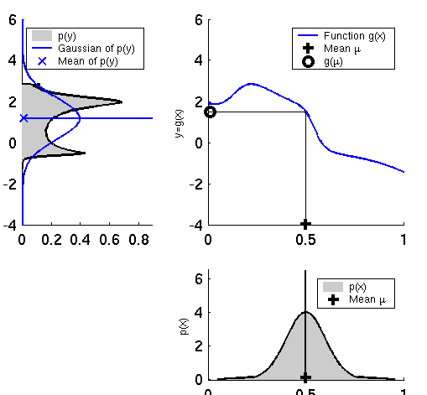
Non-linear Function

Slide 35
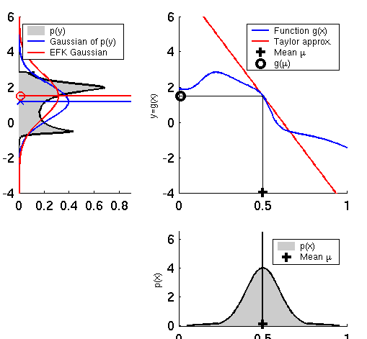
EKF Linearization (1)

Slide 36
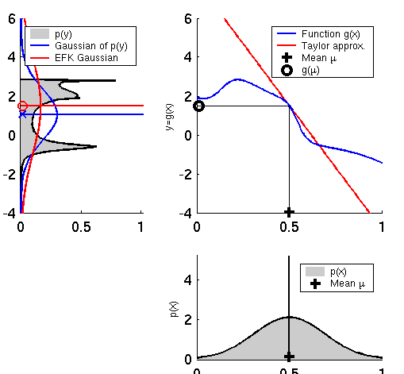
EKF Linearization (2)

Slide 37
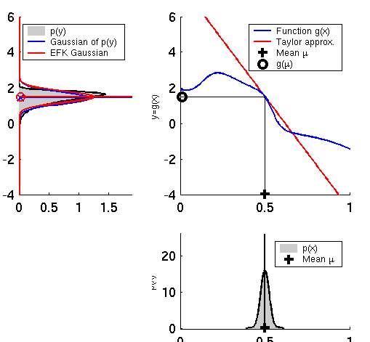
EKF Linearization (3)

Slide 38
EKF Linearization: First Order Taylor Series Expansion
Prediction:
Correction:

Slide 39
EKF Algorithm
Extended_Kalman_filter( μ_{t-1}, Σ_{t-1}, u_{t}, z_{t}):
Prediction:
Correction:
Return μ_{t}, Σ_{t}

Slide 40
Homework
Mathematical derivation of Kalman Filter based on Bayes Filter.

